Slide 1
Analysis of Renewable Energy Usage Trends: A Statistical Approach
A Statistical Analysis on Household Renewable Energy Consumption

Slide 2

Context
Introduction
Objectives
Methodology
Key Findings
Challenges
Recommendations
Conclusion

Slide 3
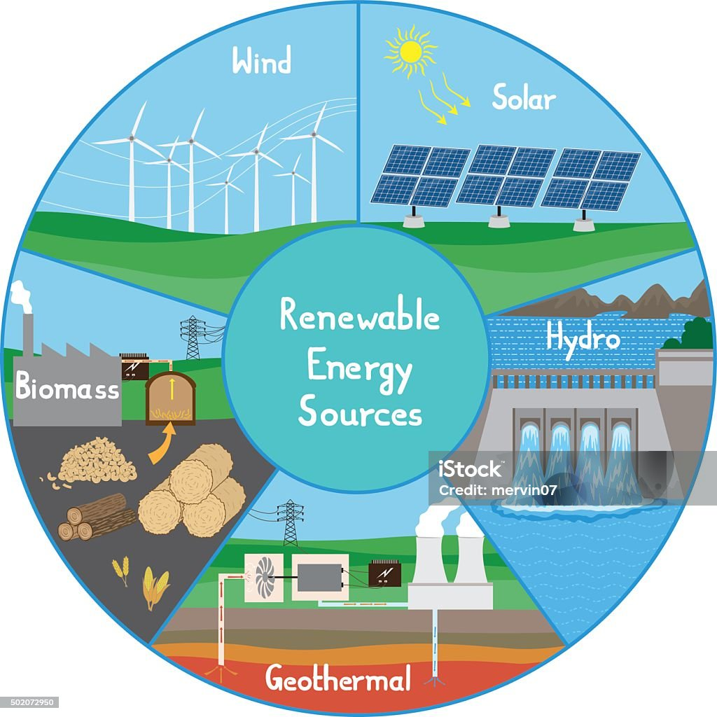
Introduction
The increasing global demand for sustainable energy has driven the adoption of renewable energy sources like solar, wind, hydro, biomass, and geothermal. This study examines household energy consumption patterns using data from 1,000 households across 25 countries and six regions.

Slide 4
Objectives
• Analyze household renewable energy consumption patterns
• Identify commonly used renewable energy sources
• Examine the impact of household size, income, and subsidies
• Assess government subsidies' effectiveness in promoting adoption
• Provide policy recommendations for sustainable energy use

Slide 5
Methodology
• Data Collection: Survey data from 1,000 households across 25 countries (2020-2024)
• Key Variables: Energy source, household size, income level, subsidy status, cost savings
• Analysis Techniques:
- Descriptive statistics (mean, median, standard deviation)
- Correlation analysis (household size, income, and energy consumption)
- Regression analysis (factors influencing cost savings)
- Comparative analysis (urban vs. rural trends)

Slide 6
Key Findings
• Solar energy is the most widely adopted (45%)
• Higher energy consumption in North America (320 kWh) and lower in Africa (180 kWh)
• Larger households consume more energy (6+ members = 400 kWh/month)
• Households receiving subsidies save 67% more on energy costs

Slide 7
Challenges in Renewable Energy Adoption
• High Initial Investment Costs
• Lack of Awareness about subsidies and incentives
• Technical & Maintenance Issues
• Grid Integration Problems in remote areas

Slide 8
Recommendations
• Increase subsidies for low-income households
• Develop awareness campaigns for renewable energy
• Invest in cost-effective solar & wind technologies
• Implement smart energy tracking systems
• Support community-based renewable projects

Slide 9
Conclusion
Renewable energy adoption depends on financial incentives, infrastructure, and awareness. With proper policies, technological advancements, and community engagement, renewable energy can become a sustainable and cost-effective global solution.

Slide 10
Any questions? Azizul Islam aislam18.phy.bu@gmail.com Department of Physics, University of Barishal
Thank You

